Slide 1
Crowdfunding on blockchain
By,
KATIKA NAGA ANJANEYULU 16K91A0529
KOKKERANCHA NAGA PAVAN 16K91A0530
S. SAMBA SIVA RAO 16K91A0547
MALOTHU MANASA BHAI 15K91A05K7
INTERNAL GUIDE,
SHIRISHA REDDY K

Slide 2
ABSTRACT
Today crowdfunding has an accountability problem. Why? As many as 85% delay delivery while 14% fail to deliver what was promised. So what happens if you give money to the wrong campaign and someone misuses the money? You may never want to support a tech project again. With blockchain technology, you know more information. Like who you’re going to send money to and how the creators spend the money. On the other hand, creators will receive more support for their projects with lower fees and overall cost, without hefty fees .It’s just like buying a house, and you don’t give all the money upfront. You hold some money in escrow. Only when the estate developer builds the house for you, a portion of funds is released. Likewise, crowdfunding money will not be released with the help of a smart contract until the creator is making progress on the project. So you have trust.

Slide 3
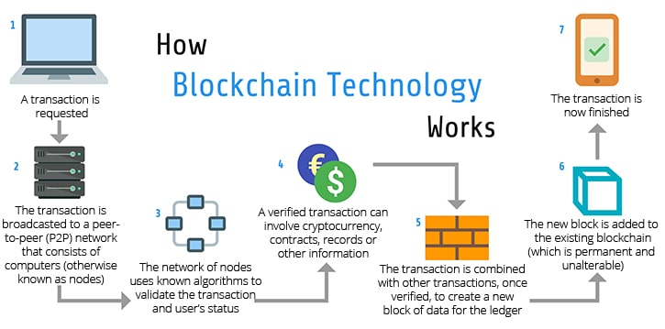

Slide 4
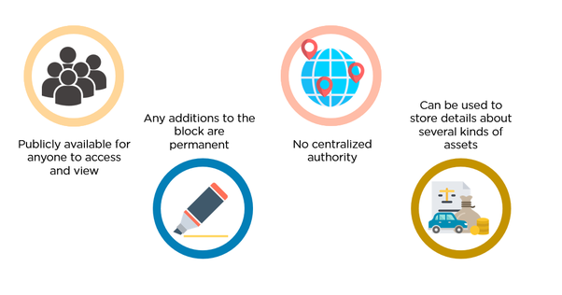
WHY Blockchain ?
History is permenant
Censorship Resistant
No Single Point of Failure

Slide 5
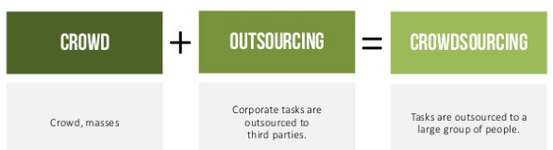
Crowdfunding is used to finance a project in the planning stage.
Crowds are encouraged to to make contributions towards projects or ventures.

Slide 6



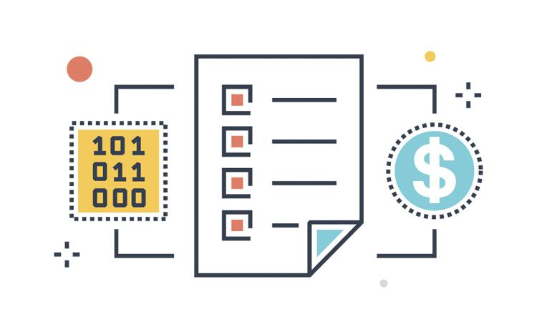
Architecture
Lists on the website
Lists on the website
Creators
Web Interface
The crowd will fund using ethereum
Receives % of allocation based on predefined rules
Funds are returned on failing to comply with the rules of smart contract
Ethereum Smart Contract

Slide 7
Existing Solution
Proposed Solution
Centralised Authority
No control over funds to backers
Misuse of funds / over expending
Full control to creators
No backer protection
No Centralised Authority
Balanced control offered to backers
Less chance of misuse of funds
Control is distributed
A percentage of backer protection on failure of the project

Slide 8
Tech Stack:
Programming languages:
Java script
Ethereum Solidity, web3
Html , css
Tools:
Ganache
Metamask
Frameworks:
React
Truffle

Slide 9




What is React.js? (Framework)
Major comapnies that use

Slide 10
What is React.js? (Framework)
React.js is an open-source JavaScript library that is used for building user interfaces specifically for single-page applications(eg Netflix). It’s used for handling the view layer for web and mobile apps.(same server for netflix but gives interface to mobile and web).
Simplicity ,easy to build
Easy to Learn lot of community support , tutorials.
Most popular front end framework(strated by facebook, used by netflix ,twitter)

Slide 11
Truffle Framework :
A world class development environment, testing framework and asset pipeline for blockchains using the Ethereum Virtual Machine (EVM), aiming to make life as a developer easier. With Truffle, you get:
•Built-in smart contract compilation, linking, deployment and binary management.
•Automated contract testing for rapid development.

Slide 12
GANACHE
Ganache is a personal blockchain for rapid Ethereum and Corda distributed application development. You can use Ganache across the entire development cycle; enabling you to develop, deploy, and test your dApps in a safe and deterministic environment.
Ganache UI is desktop application supporting both Ethereum and Corda technology. In addition, an Ethereum version of ganache is available as a command-line tool: ganache-cli (formerly known as the TestRPC). All versions of Ganache are available for Windows, Mac, and Linux.

Slide 13
Metamask
An Ethereum Wallet in your Browser
MetaMask is an extension for accessing Ethereum enabled distributed applications, or "Dapps" in your browser!
The extension injects the Ethereum web3 API into every website's javascript context, so that dapps can read from the blockchain.
MetaMask also lets the user create and manage their own identities (via private keys, local client wallet and hardware wallets like Trezor™), so when a Dapp wants to perform a transaction and write to the blockchain, the user gets a secure interface to review the transaction, before approving or rejecting it.

Slide 14
How it works:
The creators propose their idea, road map, amount of funds required , deadline .
The admin will approve their idea and lists the project with all the necessary information.
A smart contract with all the predefined rules is deployed for public to verify.
The users can then fund their desired project by sending ethereum to the smart contract.
They will in turn receive project tokens which are convertible or tradable in the future.
If the project fails to reach the the targeted fund all the money will be sent back
If the project doesn’t finish the respective phase’s deadline of the project roadmap , the investors can pull out their funds

Slide 15
Class Diagram
Dapp
+Smart contracts details
+Conditions
+Receive Funds()
+Deploy it to Blockchain()
Creator
Investor
Admin
+Details of project
+RoadMap
+Team
+Credentials
+Ethereum wallet
+Credentials
+Get it Listed on WebApp
+Receive Funds
+Send Ether to contract
+Gets refund()
+Verifies the Project()
+List it in the Site()

Slide 16
Sequence Flow Diagram
Creaotor
Web App
Investor
: Admin
Submits a proposal
Fills all the details
Accept the project and lists it on the website
send Ether to their desired project
Recieve tokens
Receive Funds
CLaom Refnd on failure

Slide 17
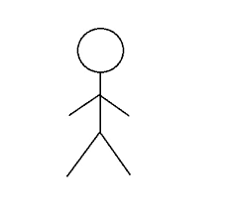
Use Case Diagram
propose the idea
get permission to list
receive funds
Creator
DAPP
approves the project
lists it on website
Admin
Backer
searches the project
donate funds with ether
recieve tokens

Slide 18
Activity Diagram
Project or Idea
Submits details abt project
Creators
Roadmap,Team Whitepaper
deploys a contract
Recieves funds in Ether
CrowdFund
Reviews the project
buys tokens
send tokens to investors
Investors
Refund on failure
Send the refund to investor

Slide 19
How to Run the Project
!. CLone the repository https://github.com/N44G/Crowdfunding-Dapp-using-ReactJs
2. install Ganache
3. install metamask and setup a wallet
4. connect ganache and metamask using local network and get them both running
5. Open the project using VS Code
6. cd to client
7. npm install
8. After succesful installation enter npm run start and the project will open in new chrome
tab or open http://localhost:3000/

